Slide 1
Private Telephone System (PBX)
Prepared By: Er. Amit Kr. Tewari
Associate Professor
CS Dept.
ACEIT, Jaipur

Slide 2
Introduction
Telephone service provided to companies or large organizations with many employees and many telephones is considerably different from basic local loop service provided for individuals.
Depending upon the size of the organization, there may be dozens, hundreds, or even thousands of telephones required.
It is simply not economical to provide each telephone in the organization with its own separate local loop connection to the central office.
It is also an inefficient use of expensive facilities to use a remote central office for intercompany communication.

Slide 3
Contd…
This problem is solved by the use of private telephone systems within a company or organization.
Private telephone systems implement telephone service among the telephones in the organization and provide one or more local loop connections to the central office.
The two basic types of private telephone systems are known as key systems and private branch exchanges.

Slide 4
Key Systems
Key systems are small telephone systems designed to serve from 2 to 50 user telephones within an organization.
Commercially available systems usually have provisions for 6, 10, 12, or 50 telephones.
Simple key telephone systems are made up of the individual telephone units generally referred to as stations, all of which are connected to a central answering station.
The central answering station is connected to one or more local loop lines known as trunks back to the local exchange.
Most systems also contain a central electronic switching unit that makes all the internal and external connections.
The telephone sets in a key system typically have a group of pushbuttons that allow each telephone to select two or more outgoing trunking lines. Phone calls are made in the usual way.

Slide 5
Private Branch Exchange (Introduction)
A private branch exchange, or PBX, as it is known, is a private telephone system for larger organizations.
Most PBXs are set up to handle 50 or more telephone interconnections.
They can handle thousands of individual telephones within an organization.
These systems may also be referred to as private automatic branch exchanges (PABXs) or computer branch exchanges (CPXs).
Of the three terms, the expression PBX is the most widely known and used.

Slide 6
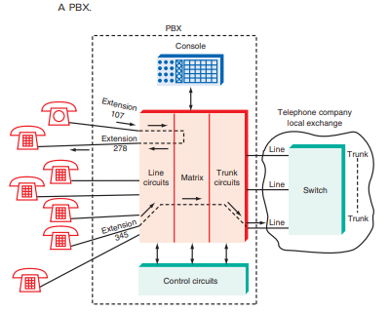

Slide 7
Private Branch Exchange (Working)
A PBX is, in effect, a miniature complete telephone system.
It provides baseband interconnections to all the telephones in an organization.
All the telephones connect to a central switching system that makes intercompany connections as well as external connections to multiple trunk lines to the central office.

Slide 8
Private Branch Exchange (Working)
The modern PBX is usually fully automated by computer control.
Although no operator is required, most large organizations have one or more operators who answer incoming telephone calls and route them appropriately with a control console.
However, some PBXs are automated so that the individual user’s telephone whose extension is the last four digits of the telephone number can be called directly from outside.

Slide 9
Private Branch Exchange (Working)
the PBX is made up of line circuits that are similar to the subscriber line interface circuits discussed earlier.
The matrix is the electronic switch that connects any phone to any other phone in the system.
It also permits conference calls.
The trunk circuits interface to the local loop lines to the central office. All the circuits are under the control of a central computer dedicated to the operation of the PBX.

Slide 10
Advantages & Disadvantages
Like the key system, the PBX offers the advantages of efficiency and cost reduction when many telephones are required.
Interoffice calls can be completed by the PBX system without accessing the local exchange.
Furthermore, it is more economical to limit the number of trunk lines to the central office, for not all telephones in the organization will be attempting to access an outside line at one time.

